Slide 1

Operational Risk Modelling AMA (The advanced measurement approach for banks) DRAFT – under construction
Marcin Miczka
Warszawa, August 2019

Slide 2
Summary
Definition of Operational Risk,
Main approaches to Operational Risk Measurement,
Capital calculation,
AMA risk management and measurement tools,
Units of Measure - combination of risk category and organizational unit,
Regulatory capital vs. Economic capital,
Low/High frequency high/low severity events,
Process of Economic Capital Calculation,
Risk Measures,
Scenarios,
Scenarios-Weighted Maximum Likelihood Approach,
LDA-Estimation of parameters,
LDA-Gluing/Mixing,
LDA-Credibility Weights,
LDA-Simulation,
LDA-Aggregation, Clayton copula,
LDA-Allocation,
Operational Risk Management – future directions,
The future of bank risk management (McKinsey&Company).

Slide 3
Definition of Operational Risk
Operational risk is the risk of loss resulting from inadequate and failed internal processes, people or systems or from external events. This definition includes legal risk, but excludes strategic and reputational risk.
Losses
Internal processes
People
Systems
External events
Operational risk (OpRisk) is the youngest of the three major risk branches, the others being market and credit risks. The term OpRisk started to be used after the Barings event in 1995, when a rogue trader caused the collapse of a venerable institution by placing bets in the Asian markets and keeping these contracts out of sight of management. At the time, these losses could be classified neither as market nor as credit risks and the term OpRisk started to be used in the industry to define situations where such losses could arise.

Slide 4
Main approaches to Operational Risk Measurement
Capital requirements decrease
AMA
(Loss Distribution Approach)
Accuracy increase
Complexity increase
Internal Measurement Approach
Standardised Apprach
Base ratio (Capital Adequacy Ratio)

Slide 5
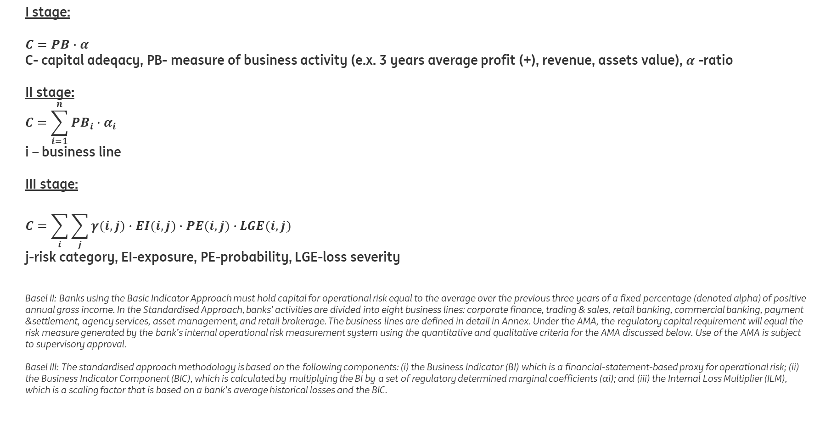
Capital calculation - historical development of methodology
I stage:
$$C=PB∙α$$
C- capital adeqacy, PB- measure of business activity (e.x. 3 years average profit (+), revenue, assets value), $α$ -ratio
II stage:
$$C=\sum_{i=1}^{n}{{PB}_{i}∙α_{i}}$$
i – business line
III stage:
$$C=\sum_{i}{\sum_{j}{γ(i,j)∙EI(i,j)∙PE(i,j)∙LGE(i,j)}}$$
j-risk category, EI-exposure, PE-probability, LGE-loss severity
Basel II: Banks using the Basic Indicator Approach must hold capital for operational risk equal to the average over the previous three years of a fixed percentage (denoted alpha) of positive annual gross income. In the Standardised Approach, banks’ activities are divided into eight business lines: corporate finance, trading & sales, retail banking, commercial banking, payment &settlement, agency services, asset management, and retail brokerage. The business lines are defined in detail in Annex. Under the AMA, the regulatory capital requirement will equal the risk measure generated by the bank’s internal operational risk measurement system using the quantitative and qualitative criteria for the AMA discussed below. Use of the AMA is subject to supervisory approval.
Basel III: The standardised approach methodology is based on the following components: (i) the Business Indicator (BI) which is a financial-statement-based proxy for operational risk; (ii) the Business Indicator Component (BIC), which is calculated by multiplying the BI by a set of regulatory determined marginal coefficients (αi); and (iii) the Internal Loss Multiplier (ILM), which is a scaling factor that is based on a bank’s average historical losses and the BIC.

Slide 6
AMA risk management and measurement tools
Fundamental AMA tools include internal loss data, external loss data, risk scenarios and business environment and internal control factors, which are addressed through risk and control self-assessments and key risk indicators.
Loss data (internal and external), key risk indicators (KRIs), risk and control self-assessment (RCSA) and scenarios are used extensively in the risk identification and management process. However, only risk scenarios and internal loss data are used in the capital calculation and allocation process. For capital purposes, all the other measurement tools are used to inform risk scenarios. External data can also be used as direct input into the capital calculation, but only after extensive development has been done (eg on selection, scaling and methodology).
Capital calculation and allocation process
Risk and control self-assesment
(RCSA)
Key risk indicators (KRIs)
External events
Loss data
(internal and external)
Scenarios
RCSA - According to this procedure, firms regularly ask experts about their views on the status of each business process
and subprocess (BICF - Business Environment and Internal Control Environment Factors)

Slide 7
Units of Measure combination of risk category and organizational unit
Risk categories/ Organizational units | Control | Processing | Internal Fraud | External fraud | Pers. & Phys. Security | Compliance | Information (Tech) | Continuity | Employment Practice | Unauthorised Activity
WB + GFA | UoM_{1,1} | UoM_{1,2} | UoM_{1,3} | … | … | … | … | … | … | UoM_{1,10}
WB + Commercial Banking | UoM_{2,1} | … | … | … | … | … | … | … | … | …
Belux + Commercial Banking | UoM_{3,1} | … | … | … | … | … | … | … | … | …
Belux + Retail Banking | … | … | … | … | … | … | … | … | … | …
C&G Challengers + Retail Banking | … | … | … | … | … | … | … | … | … | …
C&G Growth + Retail Banking | … | … | … | … | … | … | … | … | … | …
DB NL + Retail Banking | … | … | … | … | … | … | … | … | … | …
FM + Financial Markets | UoM_{8,1} | … | … | … | … | … | … | … | … | UoM_{8,10}
ING
Aggregation (dependence)
Allocation

Slide 8
Hierarchical structure

Slide 9
Regulatory capital vs. Economic capital
Economic Capital: Economic capital is the amount of capital that a bank needs to run the business and remain solvent. Also called the risk capital, it is defined as a capital required to absorb the impact of unexpected losses during a time horizon at a certain level of confidence. This is calculated by banks themselves using their own risk models.
Regulatory Capital: In most countries, the country regulators specify the amount of capital that a bank is required to hold. This acts as a buffer in place of economic capital.
Expected loss:
cover current activity
Unexpected loss:
cover capital
Catastrophic loss:
cover insurance

Slide 10
Low/High frequency high/low severity events
High frequency low severity events
Low frequency high severity events
Reporting threshold is calculated on the basis of external data (proper quantile), and use to ELD, ILD. Scenario threshold is assumed by 1:10 years.
Frequency
Reporting threshold
ORX data are not filtered to exclude ING data
Number of events increase
Bias increase
Number of events decrease
Bias decrease
Severity

Slide 11
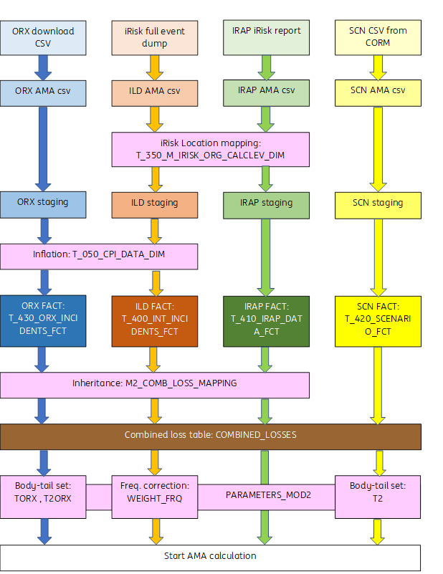
Data sources and data processing (SAS)
NFR doesn’t use trending in case of CPI calculation

Slide 12
Process of Capital Calculation
Data (UoM level)
Estimation
(UoM level)
Mixing/Gluing
(UoM level)
Simulation
(UoM level)
Aggregation
(Org. Unit/ING level)
Allocation
(Org. Unit/UoM level)
Overall Frequency Distr.
Exp. Shortfall
Volatility Tau
RCSA
Severity Distr. – Body (RCSA)
Weights
Body
Weight=0.5
Value of tail dependence (Teta)
Internal Data – ILD
Severity Distr. – Body (ILD)
Mixed Severity Distr. – Body and Tail
Loss Distr.
Overall
Clayton copula
Mixed Body Dist.
External Data – ORX
Euler method
Severity Distr. - Tail (ELD)
Threshold detection
Credibility weights
Aggregated Loss Distr.
Overall
Scenarios
Gluing body and tail
Aggregated Diversified Capital
Capital at all required Bank levels
BEICF
Body and ELD tail Dist.
Body and scenario tail Dist.
Scenario Analysis
Severity Distr. – Tail (SA)
ALGO First Data
Exp. loss
Reg. Capital

Slide 13
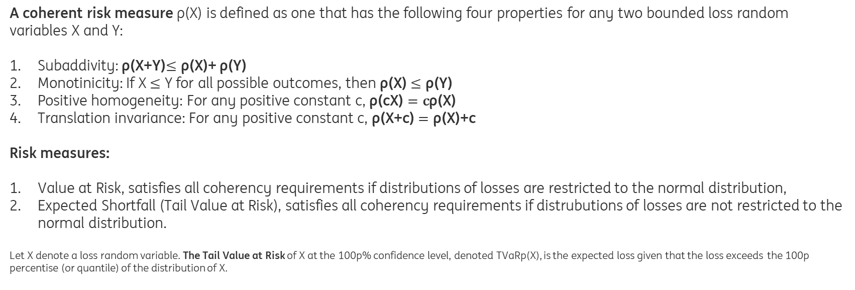
Loss Distribution Approach (LDA) – Risk Measures
A coherent risk measure ρ(X) is defined as one that has the following four properties for any two bounded loss random variables X and Y:
Subaddivity: ρ(X+Y)$≤\text{ρ}\text{(}\text{X}\text{)}$+ ρ(Y)
Monotinicity: If X $≤$ Y for all possible outcomes, then ρ(X) $≤\text{ρ}\text{(}\text{Y}\text{)}$
Positive homogeneity: For any positive constant c, ρ(cX) $=\text{c}\text{ρ}\text{(}\text{X}\text{)}$
Translation invariance: For any positive constant c, ρ(X+c) $=\text{ρ}\text{(}\text{X}\text{)+}\text{c}$
Risk measures:
Value at Risk, satisfies all coherency requirements if distributions of losses are restricted to the normal distribution,
Expected Shortfall (Tail Value at Risk), satisfies all coherency requirements if distrubutions of losses are not restricted to the normal distribution.
Let X denote a loss random variable. The Tail Value at Risk of X at the 100p% confidence level, denoted TVaRp(X), is the expected loss given that the loss exceeds the 100p percentise (or quantile) of the distribution of X.
Subadditivity means that the risk measure (and hence the capital required to support it) for two risks combined will not be greater than for the risks treated separately. This reflects the fact that there should be some diversification benefit from combining risks. This is necessary at the corporate level, because otherwise companies would find it to be an advantage to disaggregate into smaller companies. There has been some debate about the appropriate- ness of the subadditivity requirement. In particular, the merger of several small companies into a larger one exposes each of the small companies to the reputational risk of the others. We will continue to require subadditivity as it reflects the possibility of diversification. Monotonicity means that if one risk always has greater losses than another risk under all circumstances, the risk measure (and hence the capital required to support it) should always be greater. This requirement should be self- evident from an economic viewpoint. . Positive homogeneity means that the risk measure (and hence the capital required to support it) is independent of the currency in which the risk is measured. Equivalently, it means that, for example, doubling the exposure to a particular risk requires double the capital. This is sensible because doubling the position provides no diversification. Translation invariance means that there is no additional risk (and hence capital required to support it) for an additional risk for which there is no additional uncertainty. In particular, by making X identically zero, the assets required for a certain outcome is exactly the value of that outcome. Also, when a company meets the capital requirement by setting up additional risk- free capital, the act of injecting the additional capital does not, in itself, trigger a further injection (or reduction) of capital

Slide 14

Scenarios
Starting point
$$F_{SCN}^{}\left(x_{10}\right)=0$$
GDP or Lognormal CDF
External Data Benchmark
Frequency
1 in 10 years
1 in 25 years
1 in 100 years
Severity
Scenario frequency is given by 0,1 (1:10 years)
Fitting severity distribution to assesment points by Weighted Maximum Likelihood Method: maximising the frequency weighted probability mass between 1 in 10 , 1 in 25 and 1 in 100 scenario severity
To model the severity of losses above the modelling threshold, we fit a shifted distribution to the data using the method of maximum likelihood. This corresponds to deducting the value of the modelling threshold (T1) from all losses (above modelling threshold) and fitting a distribution as if there was no threshold.

Slide 15
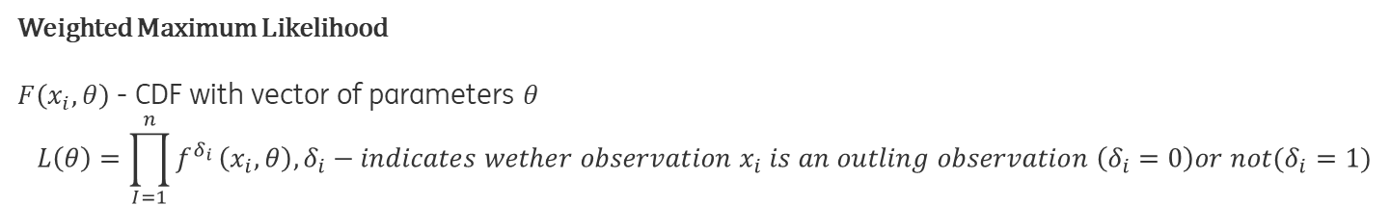
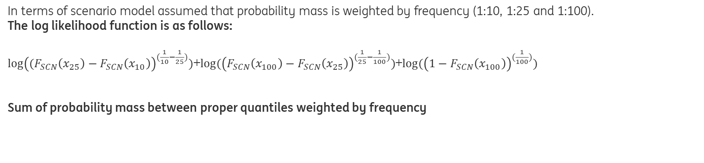
Scenarios-Weighted Maximum Likelihood Method
Weighted Maximum Likelihood
$F\left(x_{i}, θ\right)$ - CDF with vector of parameters $θ$
$$L\left(θ\right)=\prod_{I=1}^{n}{f^{δ_{i}}}\left(x_{i}, θ\right), δ_{i}−indicates wether observation{ x}_{i} is an outling observation \left(δ_{i}=0\right)or not(δ_{i}=1)$$
In terms of scenario model assumed that probability mass is weighted by frequency (1:10, 1:25 and 1:100).
The log likelihood function is as follows:
$log⁡{\left((F_{SCN}\left(x_{25}\right)−F_{SCN}\left(x_{10}\right)\right)}^{(\frac{1}{10}−\frac{1}{25})})$+$log⁡{(\left(F_{SCN}\left(x_{100}\right)−F_{SCN}\left(x_{25}\right)\right)}^{(\frac{1}{25}−\frac{1}{100})})$+$log⁡{(\left(1−F_{SCN}\left(x_{100}\right)\right)}^{(\frac{1}{100})})$
Sum of probability mass between proper quantiles weighted by frequency
Intuitively, this maximizes the "agreement" of the selected model with the observed data.
The method of maximum likelihood selects the set of values of the model parameters that maximizes the likelihood function.
Weighted Maximum Likelihood is a kind of robust approach to estimation of distribution’s parameters (if exist outlying observations).

Slide 16
Loss Distribution Approach (LDA) –Estimation of parameters
 | Severity Body | Severity tail | Frequency
ILD (Internal losses) | Shifted: Exponential, Gamma, Lognormal, Weibull (Maximum likelihood estimation) | x | Poisson (Average yearly count of internal losses or 1:10 years)
RCSA
ILD+RCSA
Scenario | x | Burr, Gamma, Generalised Pareto, Inverse Gaussian, Levy, LogGamma, LogLogistic, LogNormal, Weibull (Maximulm likelihood estimation)
ORX (External losses)
Scenario+ORX
Goodness of fit tests:
Log likelihood,
Kolmogorov-Smirnov (body),
Cramer-von Mises,
Anderson Darling Supermum,
Anderson Darling Right Tail Supremum,
Anderson Darling Right Tail Quadratic,
Anderson Darling Right Tail Quadratic Adjusted (tail).

Slide 17
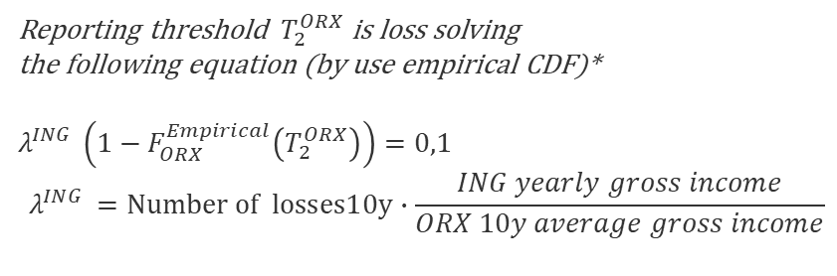

Loss Distribution Approach (LDA) – Gluing/Mixing
Mixing internal and external distributions by use credibility weights
Reporting scenario threshold
Reporting threshold ${ T}_{2}^{ORX}$ is loss solving
the following equation (by use empirical CDF)*
$$λ^{ING }\left(1−F_{ORX}^{Empirical}\left(T_{2}^{ORX}\right)\right)=0,1$$
$$λ^{ING }=Number of losses10y∙\frac{ING yearly gross income}{ORX 10y average gross income}$$
$$T_{2}^{ORX}$$
Reporting ORX threshold
Have to check reason for gluing scenario tail and body dystributions ??????
Gluing for calculating scenario variance
Frequency
Gluing (0.1 body+0.9 tail)
Overall disribution = body + tail
Scenario (tail)
Mix2
(WSCN+(1-W)ELD)
ILD (Body)
ELD (tail)
Mix1 ILD(0.5)+RCSA(0.5)
RCSA (Body)
*loss amount corresponding to the 1:10 frequency.
Severity
17

Slide 18
Loss Distribution Approach (LDA) – Threshold detection
Graphics tools:
Mean Excess Plot,
Hill Plot,
Gerstengarbe and Werner approach.
Quantitative techniques:
Goodness of fit tests (weighted average)
18

Slide 19
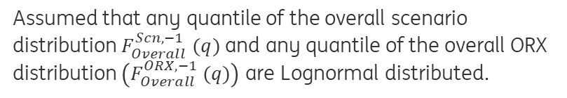
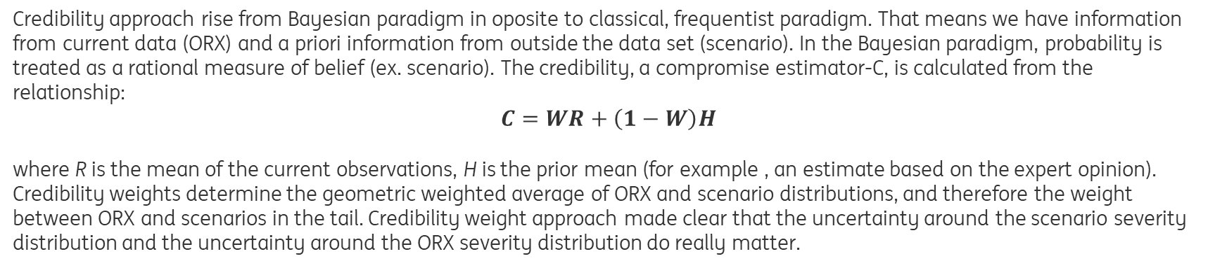
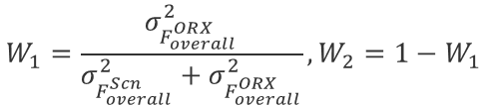
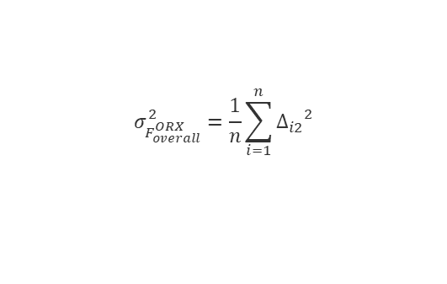


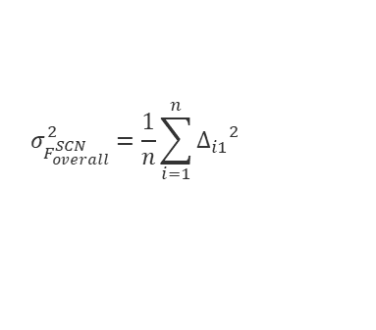
Loss Distribution Approach (LDA) – Credibility Weights Scenario vs. External data (combining operational loss data with expert opinions through advanced credibility theory)
Credibility approach rise from Bayesian paradigm in oposite to classical, frequentist paradigm. That means we have information from current data (ORX) and a priori information from outside the data set (scenario). In the Bayesian paradigm, probability is treated as a rational measure of belief (ex. scenario). The credibility, a compromise estimator-C, is calculated from the relationship:
$C=WR+\left(1−W\right)H$
where R is the mean of the current observations, H is the prior mean (for example , an estimate based on the expert opinion).
Credibility weights determine the geometric weighted average of ORX and scenario distributions, and therefore the weight between ORX and scenarios in the tail. Credibility weight approach made clear that the uncertainty around the scenario severity distribution and the uncertainty around the ORX severity distribution do really matter.
$$W_{1}=\frac{σ_{F_{overall}^{ORX}}^{2}}{σ_{F_{overall}^{Scn}}^{2}+σ_{F_{overall}^{ORX}}^{2}},W_{2}=1−W_{1}$$
Overall scenario or overall ORX distribution
$$F_{Overall}^{−1} \left(q\right)={\left(F_{Overall}^{Scn, −1} (q)\right) }^{W_{1}}×{\left(F_{Overall}^{ORX, −1} (q)\right) }^{W_{2}}$$
$$σ_{F_{overall}^{SCN}}^{2}=\frac{1}{n}\sum_{i=1}^{n}{{Δ_{i1}}^{2}}$$
$$Δ_{i1}$$
$$σ_{F_{overall}^{ORX}}^{2}=\frac{1}{n}\sum_{i=1}^{n}{{Δ_{i2}}^{2}}$$
$$Δ_{i2}$$
Assumed that any quantile of the overall scenario distribution $F_{Overall}^{Scn, −1} (q)$ and any quantile of the overall ORX distribution $\left(F_{Overall}^{ORX, −1} (q)\right)$are Lognormal distributed.
Estimated by use bootstrap sample from external data

Slide 20



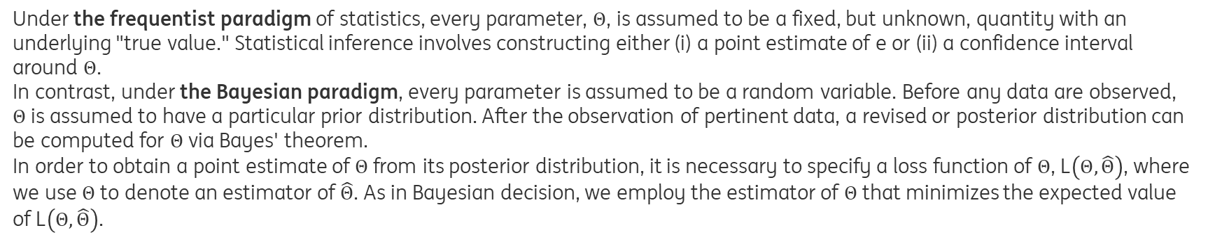
Loss Distribution Approach (LDA) – Credibility Weights Scenario vs. External data Loss function
Under the frequentist paradigm of statistics, every parameter, $Θ$, is assumed to be a fixed, but unknown, quantity with an underlying "true value." Statistical inference involves constructing either (i) a point estimate of e or (ii) a confidence interval around $Θ$.
In contrast, under the Bayesian paradigm, every parameter is assumed to be a random variable. Before any data are observed,
$Θ$ is assumed to have a particular prior distribution. After the observation of pertinent data, a revised or posterior distribution can be computed for $Θ$ via Bayes' theorem.
In order to obtain a point estimate of $Θ$ from its posterior distribution, it is necessary to specify a loss function of $Θ$, L$\left(Θ,\hat{Θ}\right)$, where we use $Θ$ to denote an estimator of $\hat{Θ}$. As in Bayesian decision, we employ the estimator of $Θ$ that minimizes the expected value of L$\left(Θ,\hat{Θ}\right)$.
Estimated by use external data
L$\left(Θ,\hat{Θ}\right)={\left(Θ−\hat{Θ}\right)}^{2}$
$$σ_{F_{overall}^{}}^{2}=\frac{1}{n}\sum_{i=1}^{n}{{Δ_{i}}^{2}}$$
$$Δ_{i}$$
Estimated by use bootstrap sample from external data

Slide 21
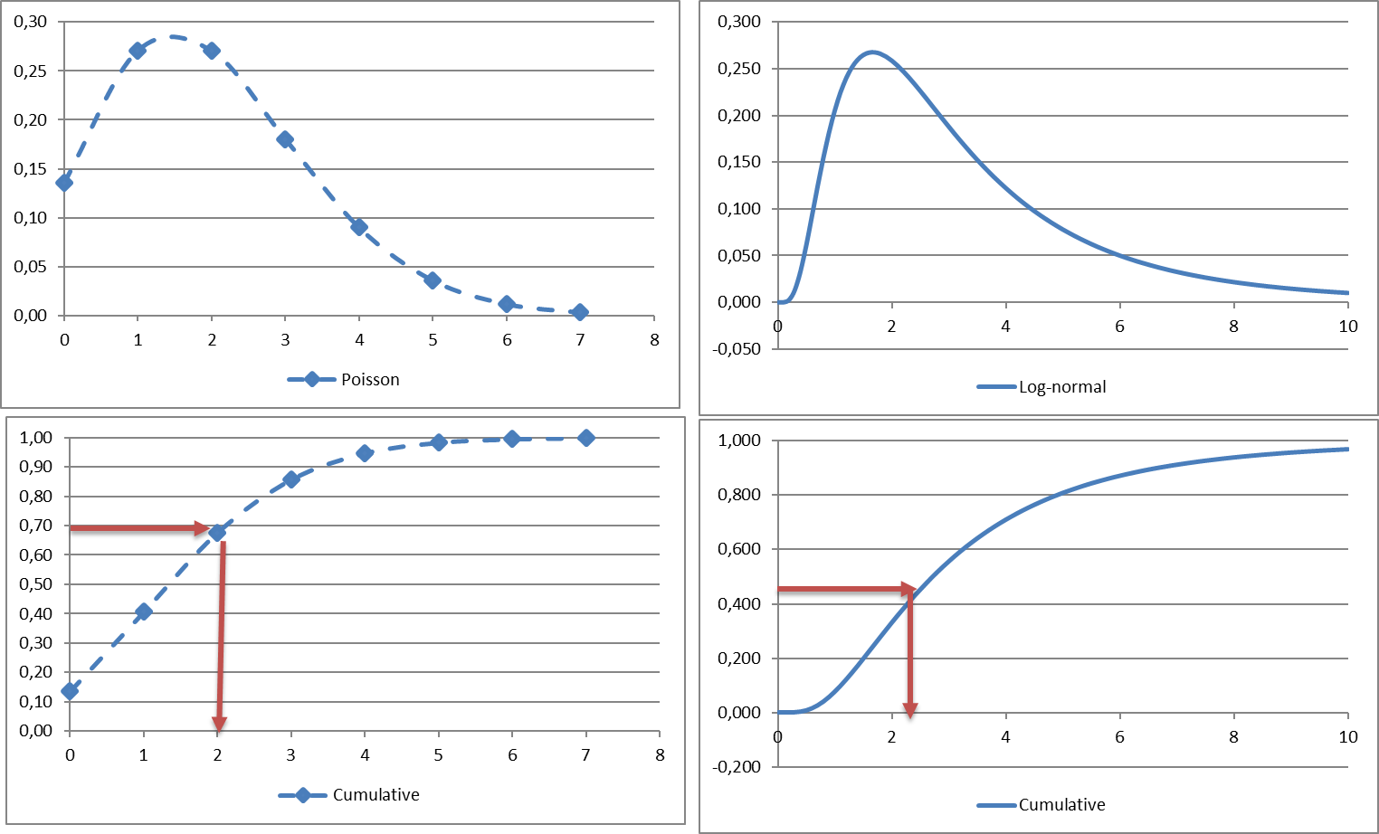
Loss Distribution Approach (LDA) – Simulation (ograniczenie wariancji ???)
Continous distibution can be discretized to speed up the proces (simulation).
Fluctuations
SAS random loss generator ???
Frequency | Sym 1 | Sym 2 | Sym 3 | Sym 4 | Sym 5 | Sym 6 | Sym 7 | Total
2,000 | 4,5 | 3,6 |  |  |  |  |  | 8,14
los log-norm | 0,77 | 0,66 | 0,68 | 0,70 | 0,54 | 0,32 | 0,89

Slide 22
Loss Distribution Approach (LDA) – Aggregation Clayton Copula, impact of dependence between risks
In operational risk, due to the nature of risk, dependence between the risks may arise in
several ways:
Frequency dependence.
Severity dependence.
Frequency and severity dependence.
Aggregate risk dependence.
In case the dependence is modelled through the aggregate risks, all the three dependence types are implicitly taken into account.
In view of the implementation of the dependence model, we obtain the following algorithm:
1. Generate aggregate loss values at each UoM (convolution of overall frequency and overall severity distributions).
2. Generate aggregate loss values at each division, using a Clayton copula and marginal aggregate loss distributions of UoMs.
3. Generate aggregate loss values at ING Bank level, using a Clayton copula and marginal aggregate loss distributions of each division.

Slide 23
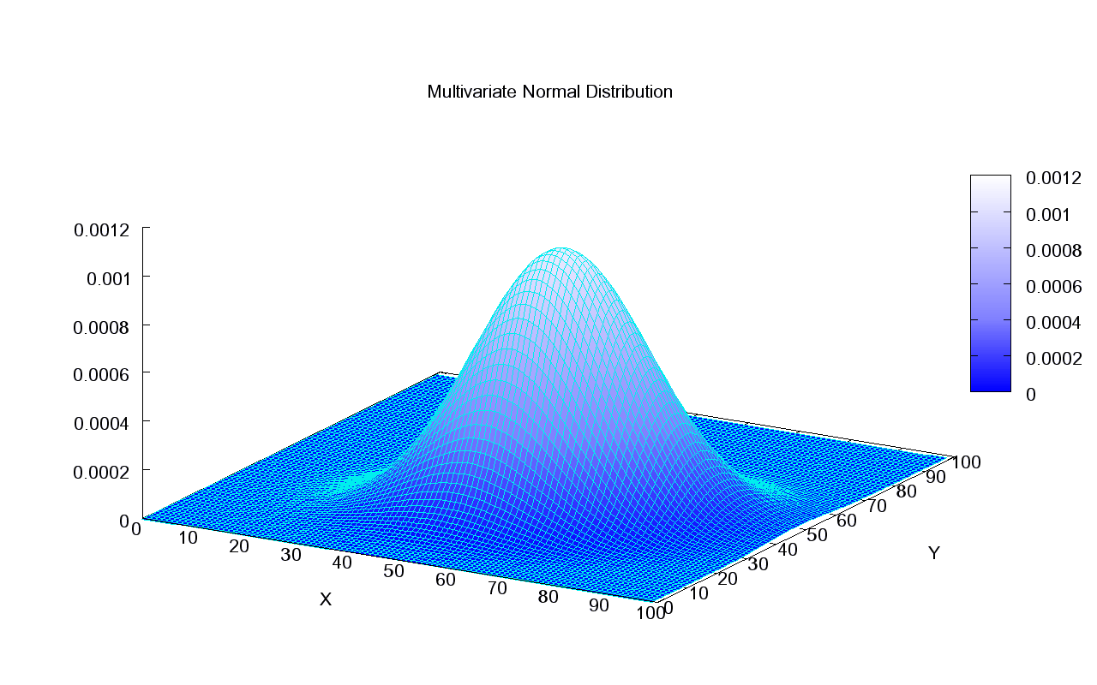
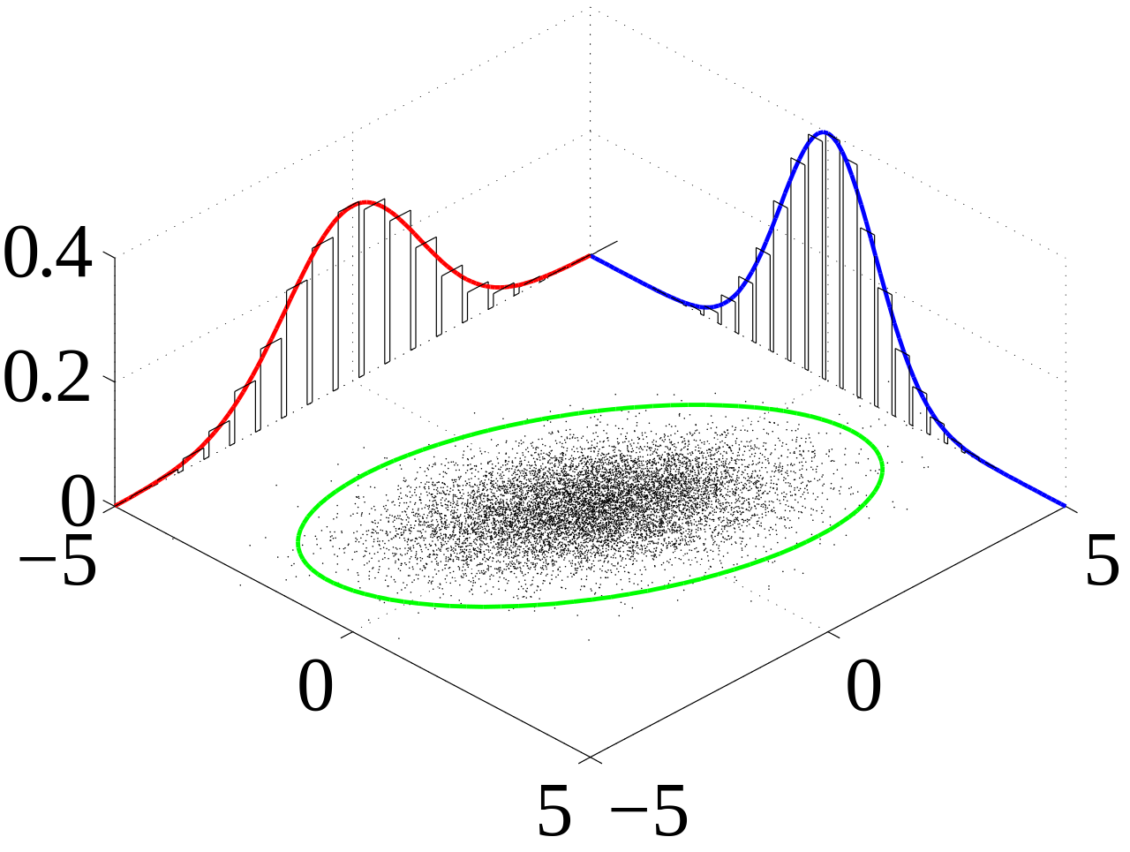
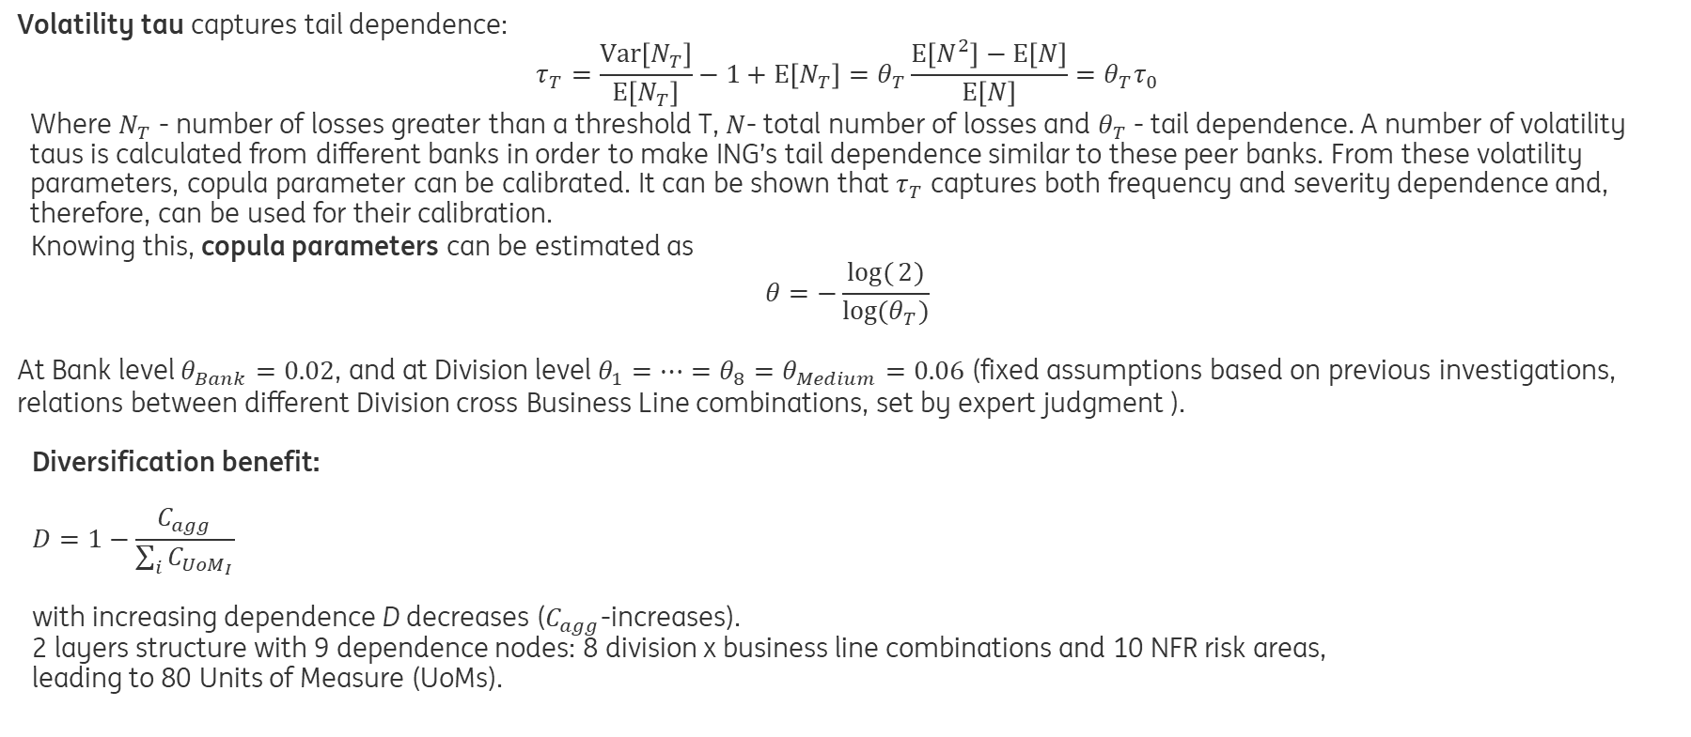
Loss Distribution Approach (LDA) – Aggregation Clayton Copula, impact of dependence between risks
If things go really wrong for one type of risk, are they more likely to go wrong for other risk catergories?
Copula (Clayton) allows for a joint distribution
that takes into account the dependencies between loss distributions:
$$F\left(x_{1},…,x_{n}\right)=C\left(F{(x}_{1}\right),…,F(x_{n}))$$
Where $C$ is the copula and $F(x_{1}),…,F(x_{n})$ the loss distributions.
Volatility tau captures tail dependence:
$$τ_{T}=\frac{\text{Var}\left[N_{T}\right]}{\text{E}\left[N_{T}\right]}−1+\text{E}\left[N_{T}\right]=θ_{T}\frac{\text{E}\left[N^{2}\right]−\text{E}\left[N\right]}{\text{E}\left[N\right]}=θ_{T}τ_{0}$$
Where $N_{T}$ - number of losses greater than a threshold T, $N$- total number of losses and $θ_{T}$ - tail dependence. A number of volatility taus is calculated from different banks in order to make ING’s tail dependence similar to these peer banks. From these volatility parameters, copula parameter can be calibrated. It can be shown that $τ_{T}$ captures both frequency and severity dependence and, therefore, can be used for their calibration.
Knowing this, copula parameters can be estimated as
$$θ=−\frac{log({2)}}{\log{(θ_{T})}}$$
At Bank level $θ_{Bank}=0.02$, and at Division level $θ_{1}=…=θ_{8}=θ_{Medium}=0.06$ (fixed assumptions based on previous investigations, relations between different Division cross Business Line combinations, set by expert judgment ).
Diversification benefit:
$$D=1−\frac{C_{agg}}{\sum_{i}{C_{{UoM}_{I}}}}$$
with increasing dependence D decreases ($C_{agg}$-increases).
2 layers structure with 9 dependence nodes: 8 division x business line combinations and 10 NFR risk areas,
leading to 80 Units of Measure (UoMs).
What impact does dependence have on the tail of the aggregate loss distribution?
While risk aggregation results in diversification benefit, dependence between the risk models reduces the impact of the risk diversification.

Slide 24
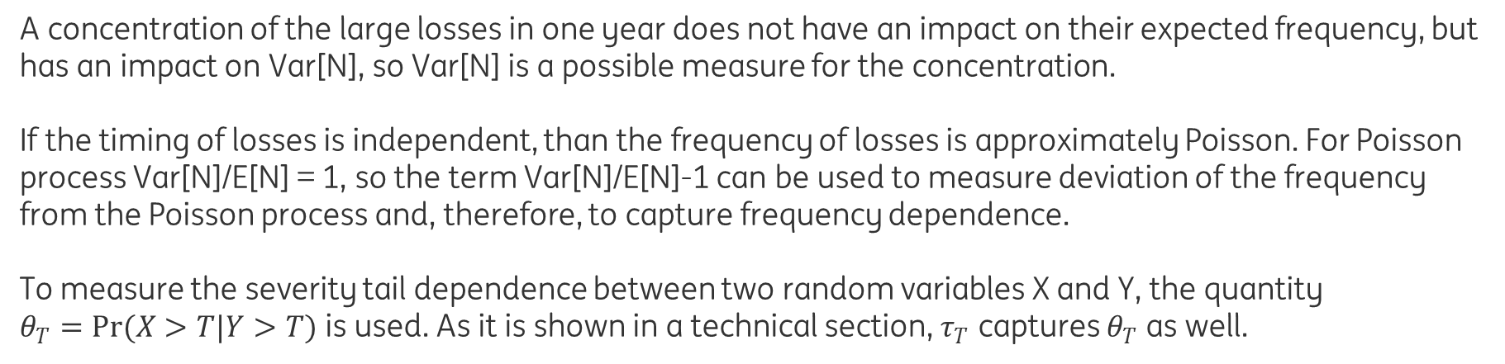
Loss Distribution Approach (LDA) – Aggregation Clayton Copula, impact of dependence between risks
A concentration of the large losses in one year does not have an impact on their expected frequency, but has an impact on Var[N], so Var[N] is a possible measure for the concentration.
If the timing of losses is independent, than the frequency of losses is approximately Poisson. For Poisson process Var[N]/E[N] = 1, so the term Var[N]/E[N]-1 can be used to measure deviation of the frequency from the Poisson process and, therefore, to capture frequency dependence.
To measure the severity tail dependence between two random variables X and Y, the quantity $θ_{T}=Pr(X>T|Y>T)$ is used. As it is shown in a technical section, $τ_{T}$ captures $θ_{T}$ as well.

Slide 25
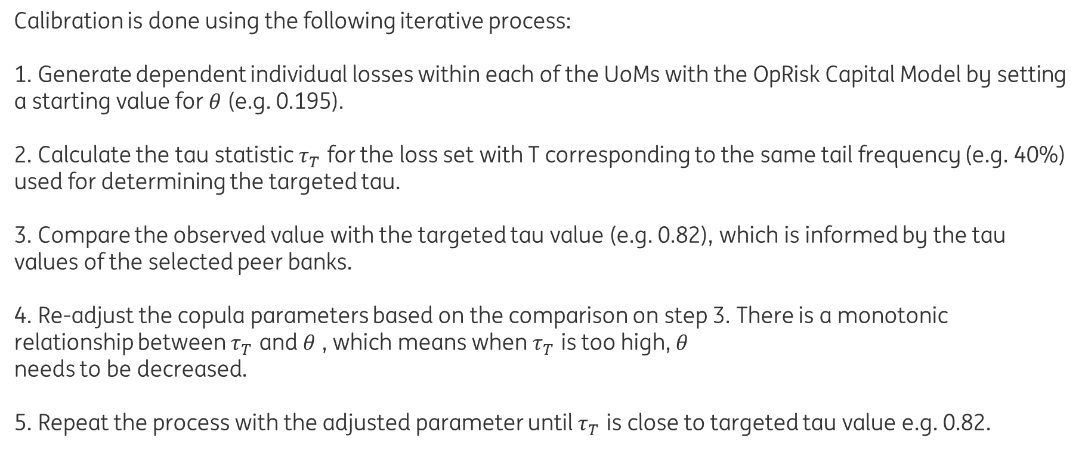
Loss Distribution Approach (LDA) – Aggregation Clayton Copula, impact of dependence between risks
Calibration is done using the following iterative process:
1. Generate dependent individual losses within each of the UoMs with the OpRisk Capital Model by setting a starting value for $θ$ (e.g. 0.195).
2. Calculate the tau statistic $τ_{T}$ for the loss set with T corresponding to the same tail frequency (e.g. 40%) used for determining the targeted tau.
3. Compare the observed value with the targeted tau value (e.g. 0.82), which is informed by the tau values of the selected peer banks.
4. Re-adjust the copula parameters based on the comparison on step 3. There is a monotonic relationship between $τ_{T}$ and $θ$ , which means when $τ_{T}$ is too high, $θ$
needs to be decreased.
5. Repeat the process with the adjusted parameter until $τ_{T}$ is close to targeted tau value e.g. 0.82.

Slide 26
Loss Distribution Approach (LDA) – Aggregation Dependence structure
Pair-wise dependence structure assumes dependence between pairs of UoM. The next figure depicts an example of pair-wise structure where each UoM is assumed to be dependent on all the other UoMs. A pair-wise dependence structure results in matrix that captures the mutual dependence parameters. Depending on the number of UoMs and their degree of dependence, this approach may lead to a large number of parameters to be calibrated. Furthermore, the dependence structure assumes dependence of only two UoMs at a time. In practice, one can observe two or more risks being dependent at the same time.
Hierarchical dependence builds dependent groups of UoMs according to a specified hierarchy and models the dependence of the groups. The next figure provides an example of a hierarchical dependence structure. At each node a dependence parameter is specified to model the dependence of UoMs connected to that node. By using hierarchical structure the number of dependence parameters can be noticeably reduced. In addition, these structures allow grouping of two or more UoMs into dependent groups.
Division level: At each division, the 10 UoMs are combined to obtain the aggregated loss at each division. There are 8 divisions.
Bank level: The losses obtained for each division are combined to obtain the aggregated loss at Bank level.

Slide 27
Loss Distribution Approach (LDA) - Allocation
Diversified Capital
Allocation at UoM Level
Allocation at underlying levels
Allocated capital at all levels
Other inputs: ES, gross income…

Slide 28
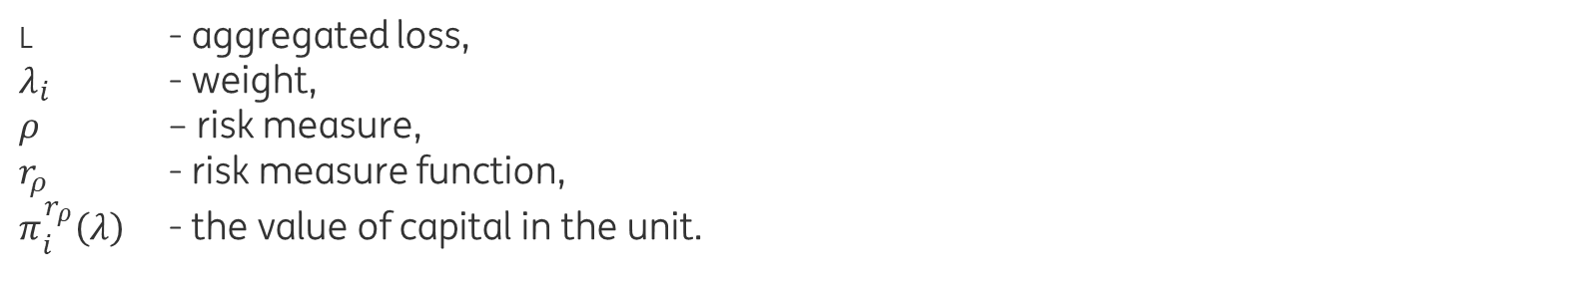
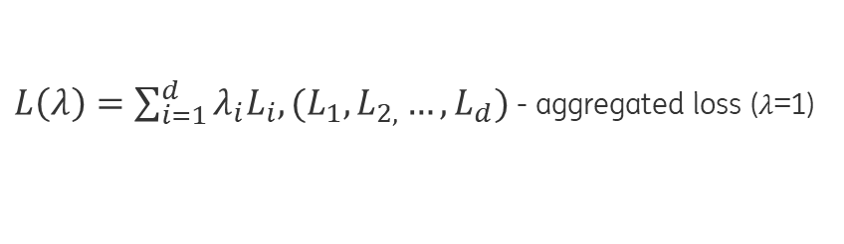


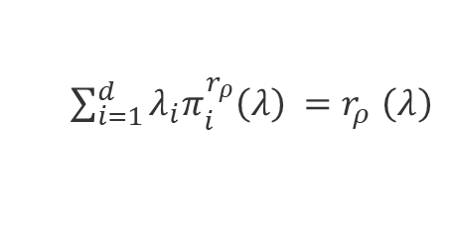

Loss Distribution Approach (LDA) – Allocation Euler Approach
$L\left(λ\right)=\sum_{i=1}^{d}{λ_{i}L_{i}, {(L}_{1},L_{2,}…,L_{d})}$ - aggregated loss ($λ$=1)
$r_{ρ}\left(λ\right)=ρ(L\left(λ\right)$)
$\sum_{i=1}^{d}{λ_{i}π_{i}^{r_{ρ}}\left(λ\right)} =$ $r_{ρ}$ $\left(λ\right)$
$r_{ρ}$ $\left(λ\right)$= $λ∘\frac{∂_{r_{ρ}}}{∂λ_{i}}$ $\left(λ\right)$
$π_{i}^{r_{ρ}}$ $\left(λ\right)$= $\frac{∂_{r_{ρ}}}{∂λ_{i}}$ $\left(λ\right)$
L - aggregated loss,
$λ_{i}$ - weight,
$ρ$ – risk measure,
$r_{ρ}$ - risk measure function,
$π_{i}^{r_{ρ}}\left(λ\right)$ - the value of capital in the unit.

Slide 29
Operational Risk Management – future directions
The objective is to produce a useful business tool rather than just a means of calculating capital
The use of insurance as a direct input into the capital model
Dynamic approach to simulation
(backward simulation method for modeling the dynamics of the operational risk events)

Slide 30
The future of bank risk management (McKinsey&Company) https://www.mckinsey.com/business-functions/risk/our-insights/the-future-of-bank-risk-management
Trend 1: Regulation will continue to broaden and deepen,
Trend 2: Customer expectations are rising in line with changing technology,
Trend 3: Technology and advanced analytics are evolving,
Big data
AI and Machine learning (self-learning models improve accuracy)
Crowdsourcing
Trend 4: New risks are emerging,
Model risk
Cybersecurity risk
Contagion risk (global market, negative market developments can quickely spread)
Trend 5: The risk function can help banks remove biases,
Trend 6: The pressure for cost savings will continue.

Slide 31
The future of bank risk management (McKinsey&Company) https://www.mckinsey.com/business-functions/risk/our-insights/the-future-of-bank-risk-management
Trend 1: Regulation will continue to broaden and deepen,
Trend 2: Customer expectations are rising in line with changing technology,
Trend 3: Technology and advanced analytics are evolving,
Big data
AI and Machine learning (self-learning models improve accuracy)
Crowdsourcing
Trend 4: New risks are emerging,
Model risk
Cybersecurity risk
Contagion risk (global market, negative market developments can quickely spread)
Trend 5: The risk function can help banks remove biases,
Trend 6: The pressure for cost savings will continue.

Slide 32
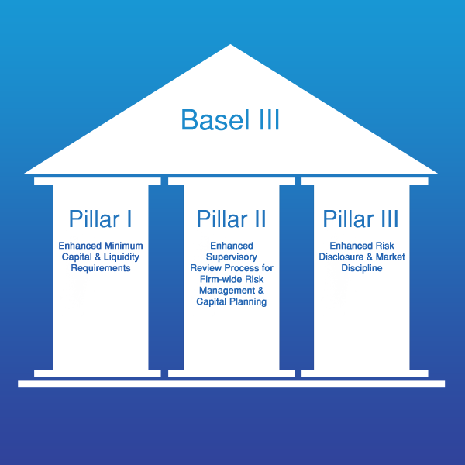
The BASEL III

